Slide 1
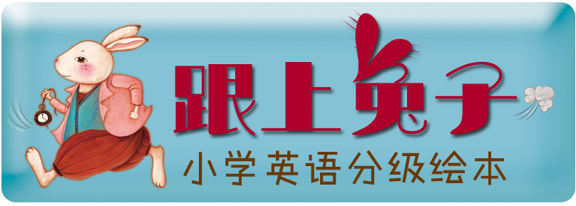
Ella

Slide 3
What’s the video about?
A the love of fathers
B the love of friends
C the love of mothers

Slide 4
Talk about your mother
My mother is …
She likes ...
She can ...
...

Slide 5
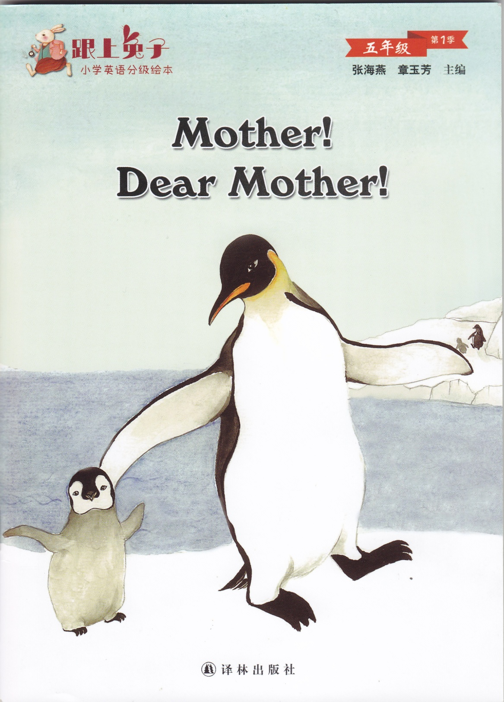
Guess: What's this picture book about?
Go through and check out.
快速翻阅书本，看你猜的对不对？

Slide 6
Task 1
Skim and find all the animal mothers in the book.
略读绘本，并找到所有提及的动物妈妈。

Slide 7
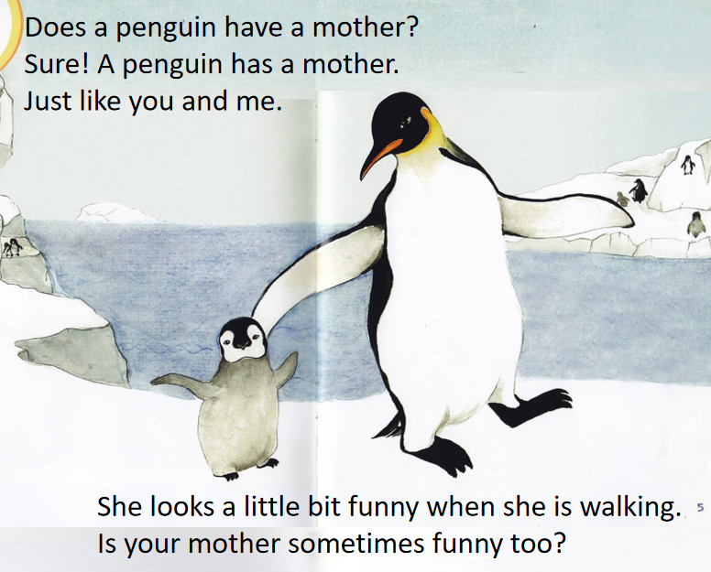
Task 2
Read again and circle the key words of the animal mothers.
再读绘本, 圈出表示“妈妈”特点的关键词。
Tips：When you meet with new words, guess the meaning from the pictures or context. 遇到生词，通过上下文或图片猜测理解。

Slide 8
elegant
Tips：When you meet with new words, guess the meaning from the pictures or context. 遇到生词，通过上下文或图片猜测理解。

Slide 9
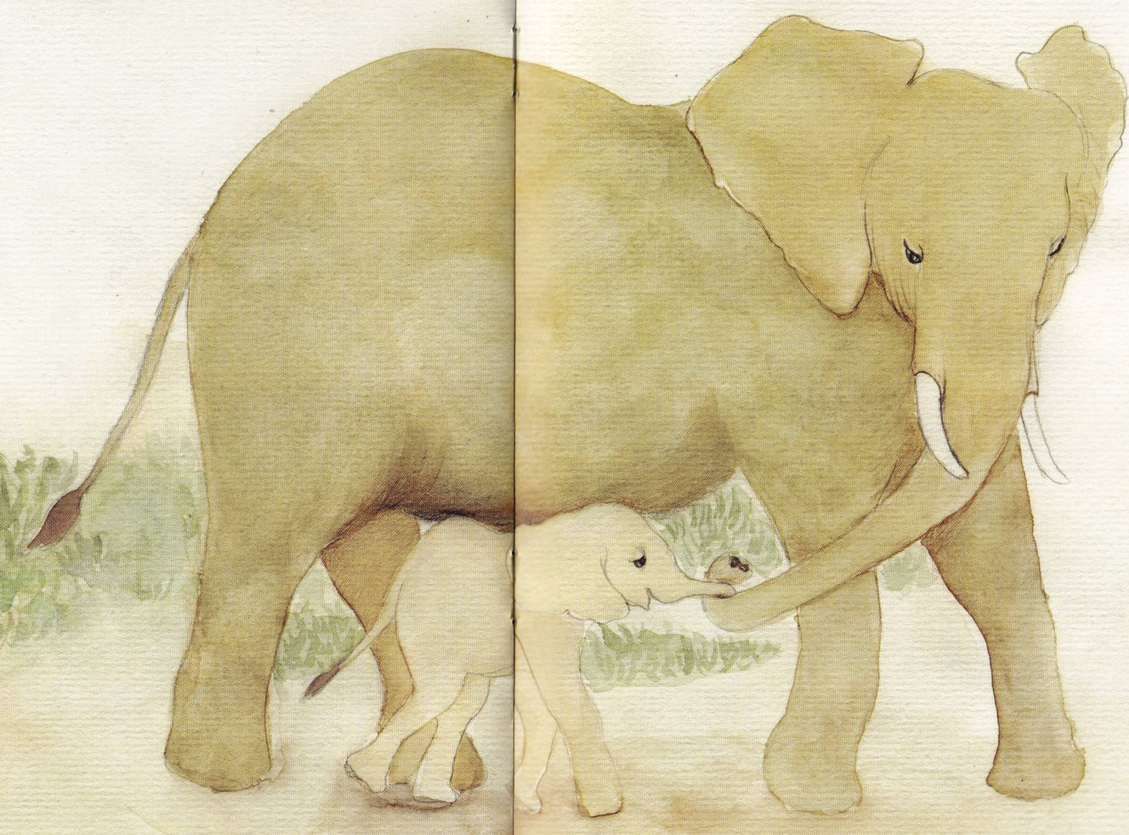
Mother elephant is like a giant.
But she is gentle when playing with her baby.
Is your mother gentle with you ?
Tips：When you meet with new words, guess the meaning from the pictures or context. 遇到生词，通过上下文或图片猜测理解。

Slide 10
Task 3
Work in pairs, and complete this picture book.
仔细阅读，小组合作一起将绘本补充完整。(答案不唯一哦。)

Slide 11
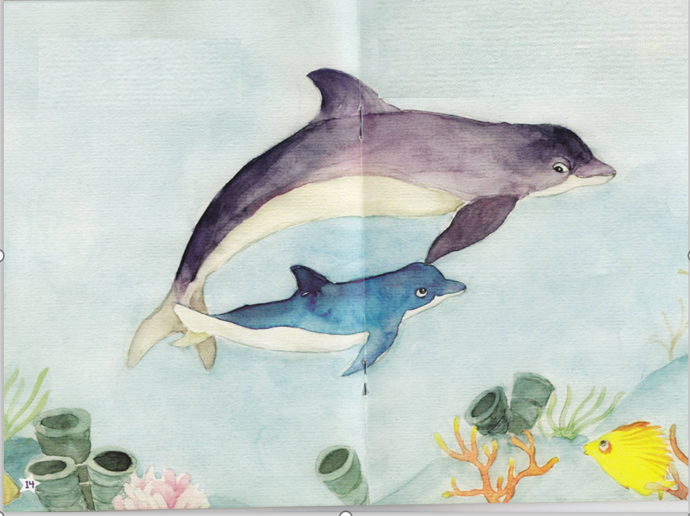
Does a dolphin have a mother too?
Sure! A dolphin has a mother too.
Just like you and me.
She swims fast.
And she is smart.
_____ your mother ______ too?

Slide 12
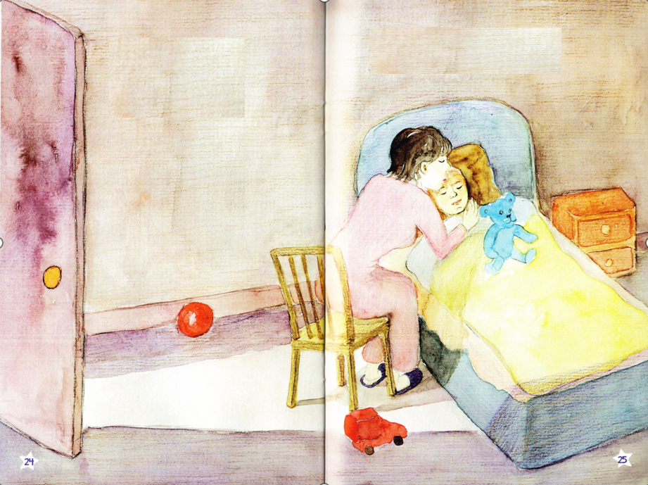
And do animal mothers ______ their babies?
Of course they do.
love
What does the story want to tell us?
All animal mothers ______ their babies.
Just like your mother ______ you.
love
loves

Slide 13
Try to remember
One of the most beautiful things in life is love
---the mother's love.
世界上最美的爱就是母爱！

Slide 14
Reader
Mother!
Dear Mother!

Slide 15
Homework
Do I have a mother too?
.... I have a mother too.
Just like them and you.
She is ... She has ... She likes ... She can ...
Do you have a mother like this?
1. Say your love to your mother.
2. Write a short essay about your mother. Try to use the simailar pattern in this book.

