Slide 1
Unit 8 Happy New Year！

Slide 2
New Year's Day: January. 1st (1月1日）
When is NeW Year's Day?
新年是什么时候?

Slide 3
Let's watch a video together!

Slide 4
Big Ben 大本钟
A large crowd of people gather under the Big Ben to welcome the New Year.
It will strike twelve at 12 o'clock.
一大群人聚集在大本钟下，迎接新年的到来。
大本钟会在零点敲响12下。

Slide 5
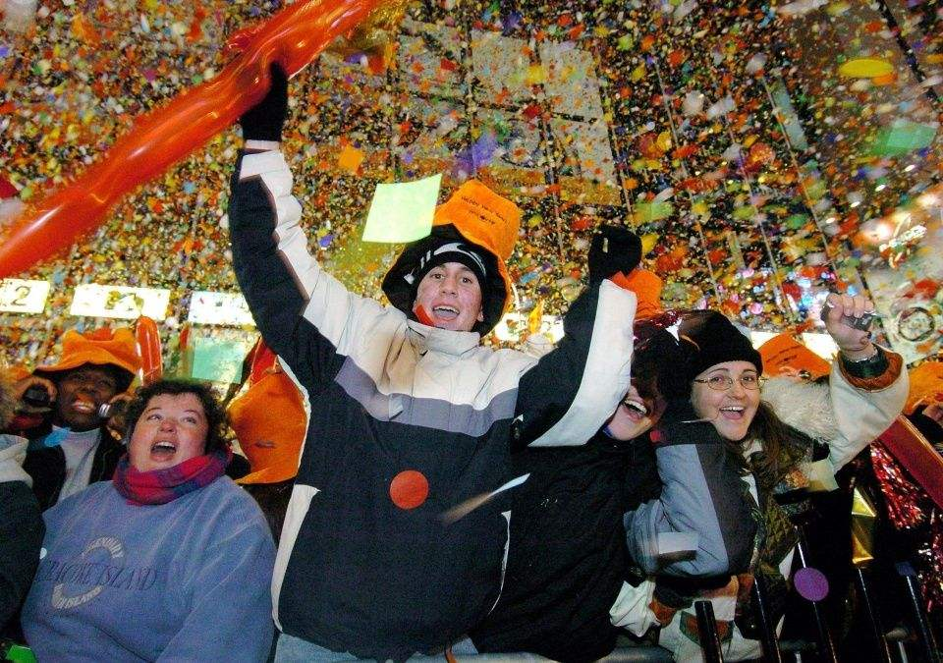
What will they say? 时钟到12点，他们互相说什么?
Happy new year!

Slide 6
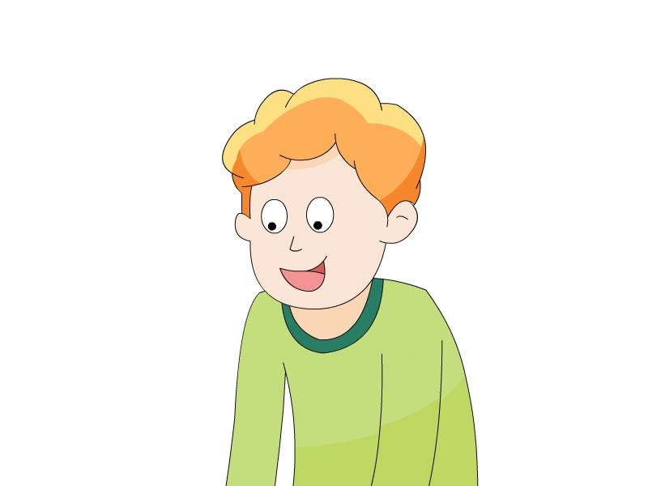
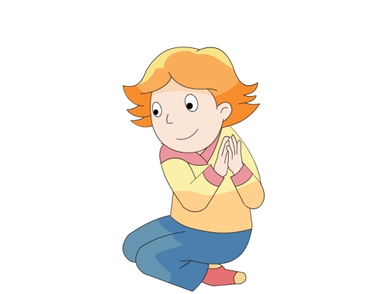
Listen to the story , then answer the questions.听录音，回答下面问题

Slide 7
Q 1 ： Who's coming?谁来了？

Slide 8
Uncle John （约翰叔叔）

Slide 9
Q 2 : What does Uncle John bring to the house? 约翰叔叔带来了什么？
A. New Year presents ( 新年礼物）
B. Nice food.

Slide 10
Q 3: How many presents does Uncle John bring? 约翰叔叔带来多少礼物？
A. 1
B. 2
C. 3

Slide 11
Q 4: What are the presents? 礼物有哪些?
A. doll, ball, robot
B. car, doll, ball
C. car, robot, CD

Slide 12
Q5: What present is for Helen?
A. It's a ball.
B. It's a doll.
C. It's a robot.

Slide 13
Q5: What present is for Mike?
A. It's a ball.
B. It's a doll.
C. It's a robot.

Slide 14
Q5: What present is for Tim?
A. It's a ball.
B. It's a doll.
C. It's a robot.

Slide 15
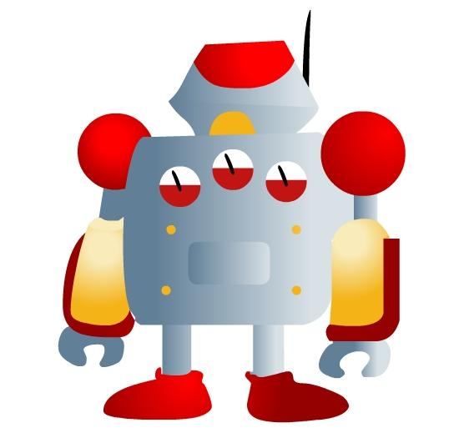
Read and match !
robot
ball
doll
Mike
Helen
Tim
It’s a . It’s for .
它是给...的。

Slide 16
Unit 8
在西方国家，当我们收到别人的礼物时，应该当面打开礼物，并且表达出对礼物的喜爱和赞美之情。
Thank you.
Thanks.
How nice!
It's nice!
Great!
....
我们可以怎样送礼物或者表达对礼物的喜爱呢？

Slide 17
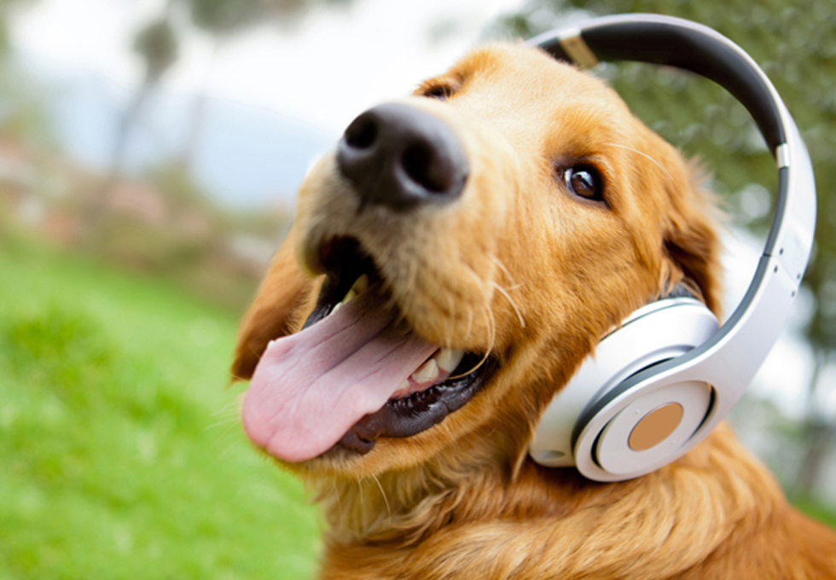
Listen again!

Slide 18
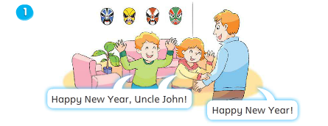
Let's listen and repeat

Slide 19
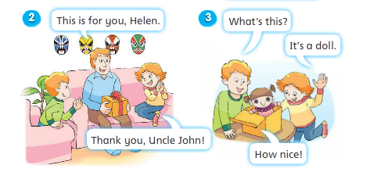
Let's listen and repeat

Slide 20
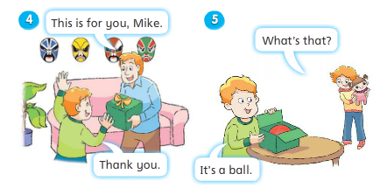
Let's listen and repeat

Slide 21
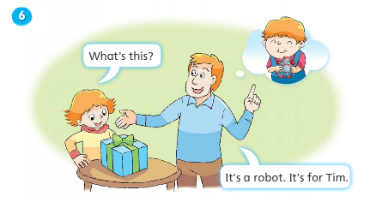
Let's listen and repeat

Slide 22
Key sentences

Slide 23
What's this?

